Slide 1
UNIT 3
DECENTRALIZATION USING BLOCKCHAIN

Slide 2
Methods of decentralization – Routes to decentralization – Blockchain and full ecosystem decentralization: Computation, Storage, Communication and decentralization – Smart Contracts – Organization of decentralization: Decentralized Autonomous: Organizations, Corporations, Societies, DApps and their requirements, Operations of DApps – Example of DApps: KYC-Chains, Open Bazzar, Lazooz

Slide 3
Methods of decentralization:
In blockchain, decentralization refers to the transfer of control and decision-making from a centralized entity (individual, organization, or group thereof) to a distributed network.
Decentralized networks strive to reduce the level of trust that participants must place in one another, and deter their ability to exert authority or control over one another in ways that degrade the functionality of the network.

Slide 4
Need for Decentralization:
Decentralization is not a new concept.
When building a technology solution, three primary network architectures are typically considered: centralized, distributed, and decentralized.
While blockchain technologies often make use of decentralized networks, a blockchain application itself cannot be categorized simply as being decentralized or not.
Rather, decentralization is a sliding scale and should be applied to all aspects of a blockchain application.
By decentralizing the management of and access to resources in an application, greater and fairer service can be achieved.
Decentralization typically has some tradeoffs such as lower transaction throughput, but ideally, the tradeoffs are worth the improved stability and service levels they produce.

Slide 5
Benefits of decentralization
Provides a trustless environment:
In a decentralized blockchain network, no one has to know or trust anyone else.
Each member in the network has a copy of the exact same data in the form of a distributed ledger.
If a member’s ledger is altered or corrupted in any way, it will be rejected by the majority of the members in the network.

Slide 6
Improves data reconciliation
Companies often exchange data with their partners.
This data, in turn, is typically transformed and stored in each party’s data silos, only to resurface when it needs to be passed downstream.
Each time the data is transformed, it opens up opportunities for data loss or incorrect data to enter the workstream.
By having a decentralized data store, every entity has access to a real-time, shared view of the data.

Slide 7
Reduces points of weakness
Decentralization can reduce points of weakness in systems where there may be too much reliance on specific actors.
These weak points could lead to systemic failures, including failure to provide promised services or inefficient service due to the exhaustion of resources, periodic outages, bottlenecks, lack of sufficient incentives for good service, or corruption.
Optimizes resource distribution
Decentralization can also help optimize the distribution of resources so that promised services are provided with better performance and consistency, as well as a reduced likelihood of catastrophic failure.

Slide 8
Methods:
Political or democratic decentralization
It involves the transfer of administrative, fiscal, and political power through the citizens or their elected representatives
It gives citizens, or their representatives, more influence in the formulation and implementation of policies through democratization
This concept implies that the selection of representatives from local electoral jurisdictions that allows citizens to know better their political representatives
Example: Free election to vote the representative of the country

Slide 9
Administrative decentralization
It seeks to redistribute authority, responsibility and financial resources among different levels of government
It has 4 forms:
a) Deconcentration
It is the weakest and inexpensive form of decentralization used frequently in unitary states
Here different levels of central government redistributes authority, financial and management responsibilities
It uses administrative means to function properly. Thus it is also called as administrative decentralization
This form of decentralization is mostly seen in developing countries

Slide 10
b) Delegation
It is more extensive form of decentralization with semi-autonomous units.
Delegation is the transfer of managerial responsibility.
Through delegation central governments transfer responsibility for decision-making and administration to semi-autonomous organizations not wholly controlled by the central government, but ultimately accountable to it
It is common form of decentralization which involves delegation of authorities and responsibilities

Slide 11
c) Devolution
It is an administrative type of decentralization and has the most common understanding of decentralization
Here the lower level units are legally constituted as separate governance bodies. Such transfer of authority are considered as devolution
Quasi-autonomous units of local government with corporate status has authority for decision-making, finance, and management
It is usually transferred to municipalities that elect their own mayors and councils, raise their own revenues, and have independent authority to make investment decisions.

Slide 12
d) Privatization
Privatization refers to the transfer of ownership from the government institutions to the private firms/institutions.
Privatization is the transfer of governmental function to private ownership.

Slide 13
3. Fiscal decentralization
Financial responsibility is a core component of decentralization
Adequate revenues are necessary to carry out decentralized functions. Thus it is either raised or transferred through the central government
Fiscal decentralization takes many forms:

Slide 14
User charges for self-financing or cost recovery
Co-financing or co-production arrangements through which the users participate in providing services and infrastructure through monetary or labor contributions
Local revenues are expanded through property or sales taxes, or indirect charges
General revenues from taxes that are collected by the central government are shifted to local governments for general or specific uses
Municipal borrowing authorization and loan guarantees for mobilization of either national or local government resources.
Example: Legal authority to impose tax

Slide 15
Economic or market decentralization
It is the most complete forms of decentralization from a government’s perspective
It includes privatization and deregulation
Responsibility for functions is shifted from the public to the private sector
It allows functions that had been primarily or exclusively the responsibility of government to be carried out by businesses, community groups, cooperatives, private voluntary associations, and other non-government organizations
Example: Electricity or broadcasting provided by various and competing companies

Slide 16
Block chain and full ecosystem decentralization:
In order to achieve complete decentralization, it is necessary that the environment around the blockchain is also decentralized.
Blockchain itself is a distributed ledger that runs on top of conventional systems.
These elements include storage, communication, and computation.
There are other factors, such as Identity and Wealth, that are traditionally based on centralized paradigms and there's a need to decentralize these aspects too in order to achieve a fully decentralized ecosystem.

Slide 17
A decentralized ecosystem surrounding blockchain technology is needed for full-solutions operations.
The blockchain represents a decentralized transaction ledger that forms a part of a larger computing infrastructure, which must consist of several other functions, including communication, storage, archiving, and file serving.
When it comes to storage, the most obvious need might be a secure, off-chain, decentralized storage for files like Electronic Medical Records, or even something as simple as a Microsoft word document.
It is worth pointing out that file storage can either be decentralized - as in the blockchain - or centralized, like Google Drive.

Slide 18
The assets can be registered by blockchain transactions, including a pointer and access method and privileges.
When it comes to file serving, the InterPlanetary File System (IPFS) project has suggested an engaging technique, which can be tailored for decentralized file serving.
The IPFS represents the need for a worldwide accessible file system, which can provide a form of resolution to the issue of broken website links to files, beyond the idea of blockchain technology.
One of the major causes of concern today is cyber security. Over the past few years, the rate of cyberattacks has risen dramatically.

Slide 19
The safety of using blockchain is a major question in the minds of many people across the globe. Blockchain technology was initially introduced to support Bitcoin.
However, since then, it has gathered so much popularity across several industries. It is no strange fact that the influence of this blockchain is beyond cryptocurrencies.
The dramatic rise in blockchain recognition has brought up questions about its security and integrity.

Slide 20
The revolution in digital money is now moving into banking. If you did not know this then you need to visit Bitcoin Prime because they offer current updates in the crypto world.
You will find several top-rated companies across the globe adopting this technology. For this reason, it is only natural to be sure that this technology is up to the task.
The data structure that blockchain produces is worth mentioning, as well as its security features. This is based on cryptography and decentralization.

Slide 21
This encourages trust during any given transaction. The blockchain consists of blocks, which contain transactions.
The blocks are cryptographically connected in such a way that they are extremely hard to alter. Besides validating transactions, which are contained in the blocks, a consensus mechanism can also ensure that all transactions are correct.
Decentralization is possible since every member of the network contributes over a distributed network.
No single point of failure can exist in such a network. As a result, no single user can change transaction records.

Slide 22
The popularity of blockchain has ensured that a wide variety of tasks can be solved.
In recent times, blockchains have become a key component that helps in setting up business processes.
Besides cryptocurrencies, Blockchain technology can be applied in workflow management, Internet-Of-Things networks, and more.
A number of businesses have found this technology a crucial component. Its high level of security can expose this technology to a great level of risk.
Besides, there is sensitive information about the assets of various users. This makes it important to have strong protection.

Slide 23
Furthermore, different blockchain networks vary in who can gain access to the data. The most common types of blockchain are either private or public.
The security measures vary with each type. While everyone is allowed to join a public blockchain network, only selected participants can engage in private blockchain networks.
However, regardless of the type of blockchain network, the anonymity of users' identities can be maintained.

Slide 24
Smart contracts
Smart contracts are simply programs stored on a blockchain that run when predetermined conditions are met.
They typically are used to automate the execution of an agreement so that all participants can be immediately certain of the outcome, without any intermediary’s involvement or time loss.
They can also automate a workflow, triggering the next action when conditions are met.

Slide 25
Smart contracts work
Smart contracts work by following simple “if/when…then…” statements that are written into code on a blockchain.
A network of computers executes the actions when predetermined conditions have been met and verified. These actions could include releasing funds to the appropriate parties, registering a vehicle, sending notifications, or issuing a ticket.
The blockchain is then updated when the transaction is completed. That means the transaction cannot be changed, and only parties who have been granted permission can see the results.

Slide 26
Within a smart contract, there can be as many stipulations as needed to satisfy the participants that the task will be completed satisfactorily.
To establish the terms, participants must determine how transactions and their data are represented on the blockchain, agree on the “if/when...then…” rules that govern those transactions, explore all possible exceptions, and define a framework for resolving disputes.
Then the smart contract can be programmed by a developer – although increasingly, organizations that use blockchain for business provide templates, web interfaces, and other online tools to simplify structuring smart contracts.

Slide 27
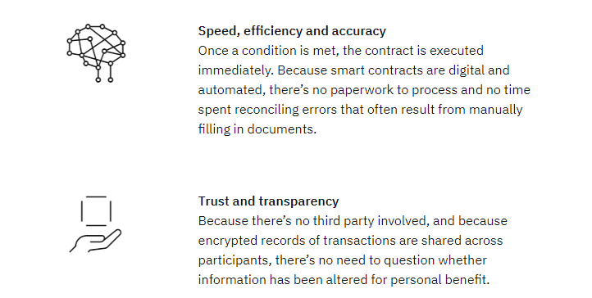
Benefits of smart contracts:

Slide 28
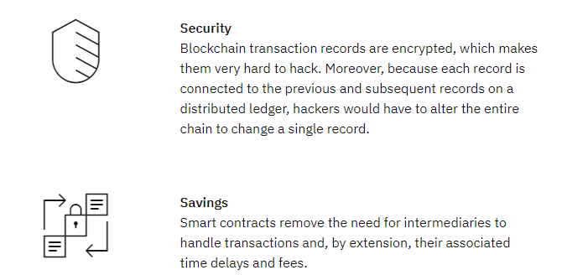

Slide 29
Applications of smart contracts:
Safeguarding the efficacy of medications:
Sonoco and IBM are working to reduce issues in the transport of lifesaving medications by increasing supply chain transparency.
Powered by IBM Blockchain Transparent Supply, Pharma Portal is a blockchain-based platform that tracks temperature-controlled pharmaceuticals through the supply chain to provide trusted, reliable and accurate data across multiple parties.

Slide 30
Increasing trust in retailer-supplier relationships:
The Home Depot uses smart contracts on blockchain to quickly resolve disputes with vendors. Through real-time communication and increased visibility into the supply chain, they are building stronger relationships with suppliers, resulting in more time for critical work and innovation.
Making international trade faster and more efficient
By joining we.trade, the trade finance network convened by IBM Blockchain, businesses are creating an ecosystem of trust for global trade.
As a blockchain-based platform, we.trade uses standardized rules and simplified trading options to reduce friction and risk while easing the trading process and expanding trade opportunities for participating companies and banks.

Slide 31
Decentralized Organization:
A company with a decentralized organizational structure is one where mid- and lower-level managers make most of the decisions, rather than the senior management team.
Sometimes the employees themselves are even involved in the decision-making process.
The opposite of a decentralized organization is a centralized one, where the highest-ranking leaders within the company make all major decisions, and there is a strict decision-making hierarchy.
Most companies are not fully decentralized or centralized, having various degrees of both instead.

Slide 32
Some of the main situations where decentralized organization works well include:
When a company has different points of contact with its customers and each requires highly individualized customer service
When an organization has a large number of different store locations and its upper management cannot monitor all of them and make important decisions for them
When the market for a specific product is fast-paced and there is intense competition, so all decisions need to be made as quickly as possible
Where new developments constantly alter the business model, making centralized control less effective

Slide 33
Benefits of decentralized organization
It lets upper management focus on the long term
Using a decentralized organization typically means that the company's owner or upper management team no longer needs to spend time with tasks such as recruiting new personnel, ordering supplies and other crucial but time-consuming tasks.
With the burden of these tasks taken by lower-level employees, the company's leaders can focus on long-term strategies.

Slide 34
It can empower employees
Giving employees the opportunity to make decisions that directly impact their work can give them a sense of importance within the organization.
This can give them the confidence they need to come up with creative solutions to complicated problems and implement them quicker than they would if they needed approval from upper management.
It can lead to quick and efficient decision-making
As opposed to a centralized structure, with decisions that usually take a long time to be approved and implemented, a decentralized one allows a lower-level manager to make a decision and implement it immediately without waiting for approval.
This can help the company in situations where quick decisions are crucial for its success.

Slide 35
Decentralized Autonomous Organization (DAO)
A decentralized autonomous organization (DAO) is an entity with no central leadership. Decisions get made from the bottom-up, governed by a community organized around a specific set of rules enforced on a blockchain.
DAOs are internet-native organizations collectively owned and managed by their members. They have built-in treasuries that are only accessible with the approval of their members. Decisions are made via proposals the group votes on during a specified period.
A DAO works without hierarchical management and can have a large number of purposes.

Slide 36
Freelancer networks where contracts pool their funds to pay for software subscriptions, charitable organizations where members approve donations and venture capital firms owned by a group are all possible with these organizations.
Before moving on, it’s important to distinguish a DAO, an internet-native organization, from The DAO, one of the first such organizations ever created. The DAO was a project founded in 2016 that ultimately failed and led to a dramatic split of the Ethereum network.

Slide 37
Working:
DAO is an organization where decisions get made from the bottom-up; a collective of members owns the organization. There are various ways to participate in a DAO, usually through the ownership of a token.
DAOs operate using smart contracts, which are essentially chunks of code that automatically execute whenever a set of criteria are met. Smart contracts are deployed on numerous blockchains nowadays, though Ethereum was the first to use them.
These smart contracts establish the DAO’s rules. Those with a stake in a DAO then get voting rights and may influence how the organization operates by deciding on or creating new governance proposals.

Slide 38
This model prevents DAOs from being spammed with proposals: A proposal will only pass once the majority of stakeholders approve it.
DAOs are fully autonomous and transparent. As they are built on open-source blockchains, anyone can view their code.
Anyone can also audit their built-in treasuries, as the blockchain records all financial transactions.

Slide 39
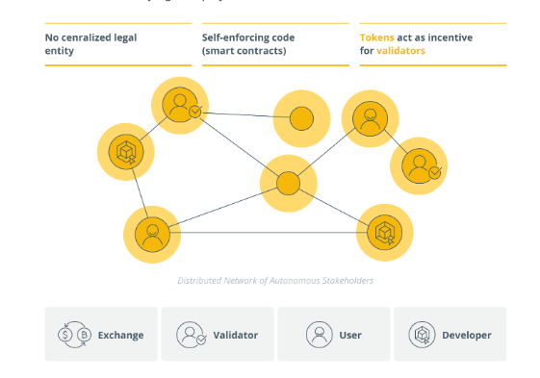

Slide 40
DAO launch occurs in three major steps:
Smart contract creation: First, a developer or group of developers must create the smart contract behind the DAO.
After launch, they can only change the rules set by these contracts through the governance system. That means they must extensively test the contracts to ensure they don’t overlook important details.
Funding: After the smart contracts have been created, the DAO needs to determine a way to receive funding and how to enact governance.
More often than not, tokens are sold to raise funds; these tokens give holders voting rights.

Slide 41
Deployment: Once everything is set up, the DAO needs to be deployed on the blockchain. From this point on, stakeholders decide on the future of the organization.
The organization’s creators — those who wrote the smart contracts — no longer influence the project any more than other stakeholders.

Slide 42
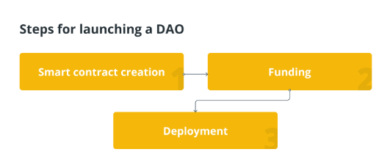

Slide 43
Disadvantages of DAOs
Decentralized autonomous organizations aren’t perfect. They are an extremely new technology that has attracted much criticism due to lingering concerns regarding their legality, security and structure.

Slide 44
DAPPS
A decentralized application (dApp) is a type of distributed open source software application that runs on a peer-to-peer (P2P) blockchain network rather than on a single computer.
DApps are visibly similar to other software applications that are supported on a website or mobile device but are P2P supported.
It enables users to engage in transactions directly with one another as opposed to relying on a central authority.

Slide 45
Requirements
For an application to be considered decentralized, it must meet the following criteria.
The DApp should be fully open source and autonomous, and no single entity should be in control of a majority of its tokens. All changes to the application must be consensus-driven based on the feedback given by the community.
Data and records of operations of the application must be cryptographically secured and stored on a public, decentralized blockchain to avoid any central points of failure.
A cryptographic token must be used by the application to provide access and rewards

Slide 46
Operations:
Decentralization offers various benefits over apps running on a centralized network.
Chiefly is the lack of a third party, thanks to the innovative smart contract.
An app like Venmo allows one to send money to anyone, however, moving those funds to a bank account costs a fee. Plus, moving fiat often takes days to arrive.
Sending money over a decentralized app, however, means there aren’t any or very little costs to be paid.
This saves users money on fees, and considering decentralized transactions are almost instant, it saves them time as well.

Slide 47
DApps don’t run on centralized servers either. An advantage decentralized platforms have is they’re invulnerable to all types of attacks, as there’s no physical device to target.
Not only does this make the network more secure, but it also means there’s no downtime.
Accessing these applications is always possible.

Slide 48
DApps can also apply to almost any industry, such as gaming, medical, governance and even file storage.
As a result, DApp usage is almost no different from traditional applications.
While users benefit from all the changes on the backend, the actual experience should be the same.
This way of interacting with applications is considered Web 3.0, also referring to the decentralization of information.

Slide 49
Companies then have control over that information, know what their users like to buy, how much money they have and who they know.
That control also means they can take it away. Enter Web 3.0, where DApp usage doesn’t come at the cost of privacy.
instead, a user can choose to share only required information for, say, a medical checkup or a loan, and choose who sees it and for how long.
Companies might pay for this access as well, ensuring that the users also profit from it.
There’s also the problem of trust. In a world where large companies with so-called high security are leaking usernames, emails and passwords, it’s hard to trust anyone completely.

Slide 50
Drawbacks:
While decentralized applications might present a future free of corporations, there are currently some major issues that the industry is working to resolve.
For one, the lack of a central authority might mean slower updates and platform changes. After all, one party can simply update their app as they please.
A DApp, however, requires majority consensus from the acting governance — even for a minor bug fix. This could take weeks or even months as users debate the pros and cons of any improvement.

Slide 51
Also, DApps require a reasonably-sized user base to operate properly. They need nodes, governance and users just to interact with it.
However, accessing DApps can be quite difficult in this early stage, and many aren’t seeing the support they need.
In the future, accessing a DApp might be a download away.
But for now, users must download a DApp-supported browser, send the required crypto to that wallet and interact from there. While tech-savvy users should have no problem with this, the vast majority of people will have no idea where to start.

Slide 52
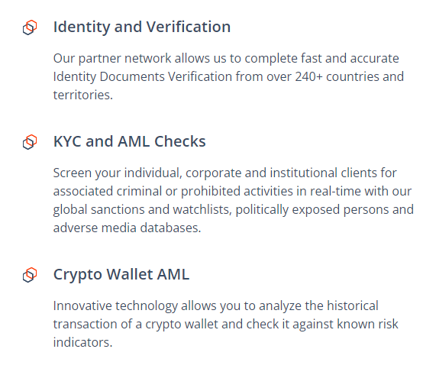
KYC-Chains, Open Bazzar, Lazooz
KYC-Chains:

Slide 53
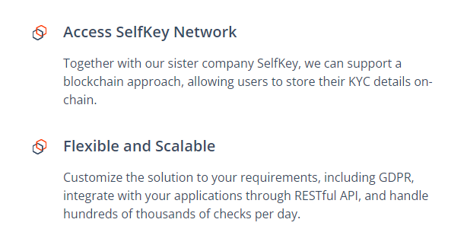

Slide 54
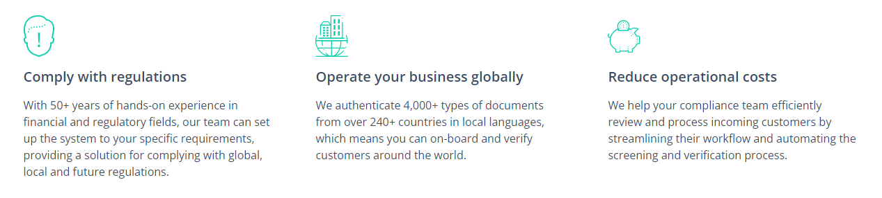
Advantages

Slide 55
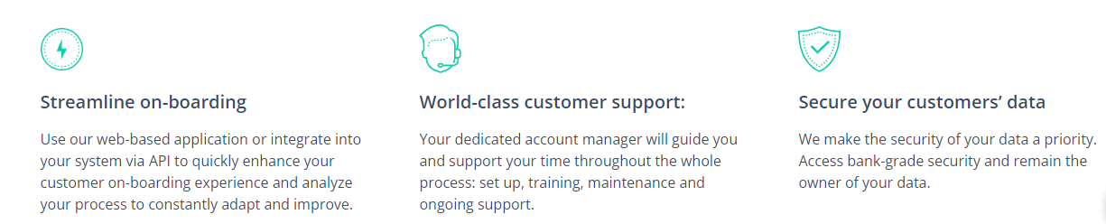

Slide 56
Open Bazaar
OpenBazaar was an open source project developing a protocol for e-commerce transactions in a fully decentralized marketplace.
It used cryptocurrencies as medium of exchange and was inspired by a hackathon project called DarkMarket.
OpenBazaar is a platform that lets buyers and sellers connect directly to sell their goods without involving a third party to host the data and charge a transaction fee.
OpenBazaar, there is no central server involved at all. It’s a peer-to-peer client to which no government entity can restrict access
OpenBazaar is a platform that lets buyers and sellers connect directly to sell their goods without involving a third party to host the data and charge a transaction fee.
The creators wanted to build on the idea of creating a truly free trade platform for people to send and receive goods without having to go through a central authority.

Slide 57
OpenBazaar is a platform that lets buyers and sellers connect directly to sell their goods without involving a third party to host the data and charge a transaction fee.
The creators wanted to build on the idea of creating a truly free trade platform for people to send and receive goods without having to go through a central authority.

Slide 58
Working:
OpenBazaar Work:
Everyone in the OpenBazaar network is a node in the P2P network.
Everyone is assigned three roles that they can build on: merchant, buyer, and/or arbiter.
You can choose what role you mainly want to build your reputation for, and you are not limited to one role.
The currency presently in use is Bitcoin, removing the barrier to entry of having to deal with a novel currency—but this also doesn’t let the developers automatically be paid for their work. Let’s talk about what the process looks like for each of these three types of actors in the network.

Slide 59
La'Zooz is a not-for profit, decentralized transportation platform owned by the community and utilizing vehicle's unused space to create a variety of smart transportation solutions.
Their initial product is a blockchain based ride-sharing app where user can share rides based on location, and pay with Zooz, app's local cryptocurrency, built on Ethereum.
In near future, La`Zooz aims to create a decentralized encrypted repository of user identity and realtime location, that can be leveraged by any service through an API, i.e. public transportation, hyperlocal delivery, on-demand, etc.

